Slide 1

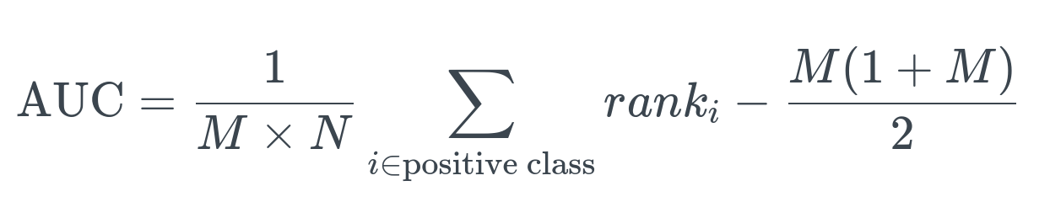
Model Evaluation - Evaluation Criteria
Accuracy - FROC
The trained MindSpore AI models should accurately locate and classify cancer cells.
Explainability (Bonus) - AUC
The trained MindSpore AI models should provides pixel level feature attribution as an explanation for the task!
The top 6 highest model score teams are invited to enter the FINAL PITCHING

Slide 2
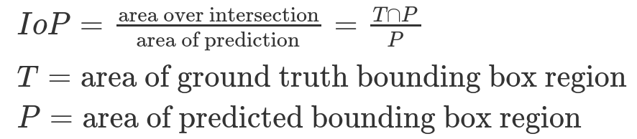
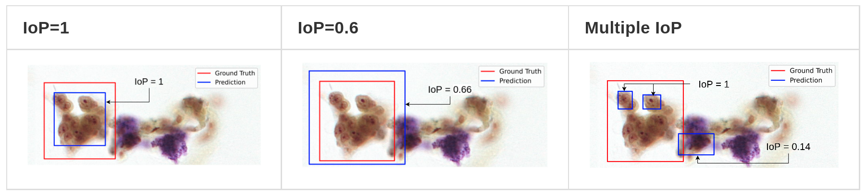
Model Evaluation - True Positive = IOP > 0.5

Slide 3
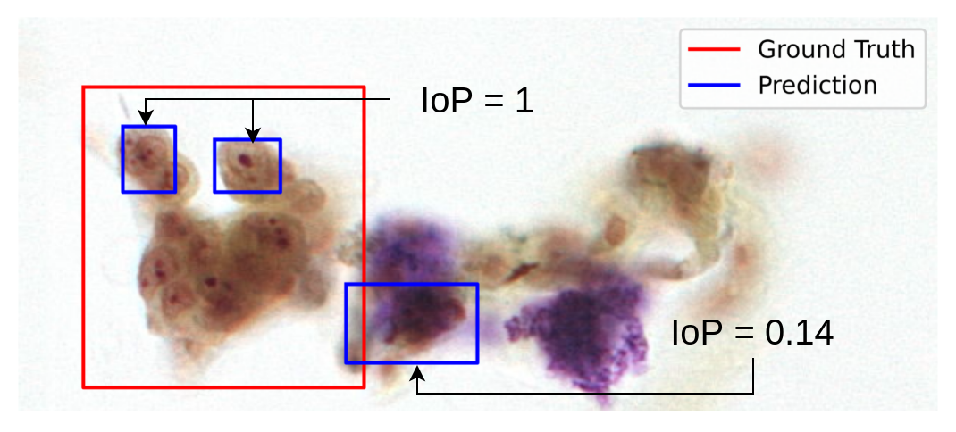
Model Evaluation -
Can you tell which one is TP and FP?
30 Seconds
How about the TP and FP count?

Slide 4
Model Evaluation -
Can you tell which one is TP and FP?
True Positives (TP)
False Positives (FP)
TP = 1
FP = 1
How about the TP and FP count?

Slide 5
Model Evaluation -
Recall vs False Positive per Image
Suppose we have: 5 ground truth bbox for 3 images
Prediction Probability | True Positive (IoP > 0.5?) | GT BBox | Counted towards
A 0.99 | Yes | 1 (IoP = 0.9), 5 (IoP = 0.7) | 1
B 0.97 | No | - | -
C 0.81 | Yes | 2 | 2
D 0.72 | Yes | 1 | 1
E 0.58 | No | - | -
... | ... | ... | ...
Notes:
Recall that each bounding box have probabilities which is sort of like a confidence to the prediction.
After classifying each bounding box to the prediction we can form a graph, like a

Slide 6
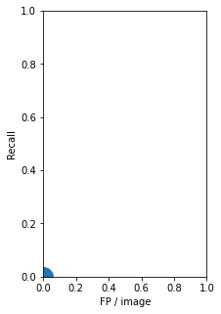
Model Evaluation -
Recall vs False Positive per Image
Suppose we have: 5 ground truth bbox for 3 images
Prediction Probability | True Positive (IoP > 0.5?) | GT BBox | Counted towards
A 0.99 | Yes | 1 (IoP = 0.9), 5 (IoP = 0.7) | 1
B 0.97 | No | - | -
C 0.81 | Yes | 2 | 2
D 0.72 | Yes | 1 | 1
E 0.58 | No | - | -
... | ... | ... | ...
Threshold Probabilities from top and find recall
and FP/image
Notes:
Recall that each bounding box have probabilities which is sort of like a confidence to the prediction.
After classifying each bounding box to the prediction we can form a graph, like a

Slide 7
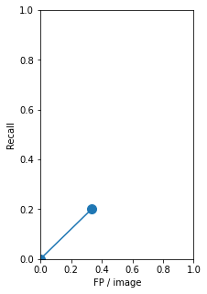
Model Evaluation -
Recall vs False Positive per Image
Suppose we have: 5 ground truth bbox for 3 images
Prediction Probability | True Positive (IoP > 0.5?) | GT BBox | Counted towards
A 0.99 | Yes | 1 (IoP = 0.9), 5 (IoP = 0.7) | 1
B 0.97 | No | - | -
C 0.81 | Yes | 2 | 2
D 0.72 | Yes | 1 | 1
E 0.58 | No | - | -
... | ... | ... | ...
Threshold = 0.9
Recall = 1 / 5
FP/ img = 1 / 3
Threshold Probabilities from top and find recall
and FP/image
Notes:
Recall that each bounding box have probabilities which is sort of like a confidence to the prediction.
After classifying each bounding box to the prediction we can form a graph, like a

Slide 8
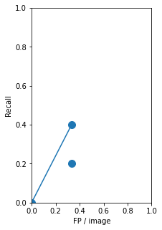
Model Evaluation -
Recall vs False Positive per Image
Suppose we have: 5 ground truth bbox for 3 images
Prediction Probability | True Positive (IoP > 0.5?) | GT BBox | Counted towards
A 0.99 | Yes | 1 (IoP = 0.9), 5 (IoP = 0.7) | 1
B 0.97 | No | - | -
C 0.81 | Yes | 2 | 2
D 0.72 | Yes | 1 | 1
E 0.58 | No | - | -
... | ... | ... | ...
Threshold = 0.7
Recall = 2 / 5
FP/ img = 1 / 3
Threshold Probabilities from top and find recall
and FP/image
Notes:
Recall that each bounding box have probabilities which is sort of like a confidence to the prediction.
After classifying each bounding box to the prediction we can form a graph, like a

Slide 9
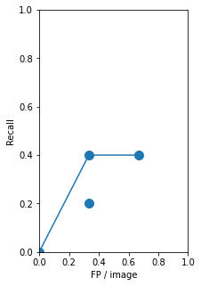
Model Evaluation -
Recall vs False Positive per Image
Suppose we have: 5 ground truth bbox for 3 images
Prediction Probability | True Positive (IoP > 0.5?) | GT BBox | Counted towards
A 0.99 | Yes | 1 (IoP = 0.9), 5 (IoP = 0.7) | 1
B 0.97 | No | - | -
C 0.81 | Yes | 2 | 2
D 0.72 | Yes | 1 | 1
E 0.58 | No | - | -
... | ... | ... | ...
Threshold = 0.5
Recall = 2 / 5
FP/ img = 2 / 3
Threshold Probabilities from top and find recall
and FP/image
Notes:
Recall that each bounding box have probabilities which is sort of like a confidence to the prediction.
After classifying each bounding box to the prediction we can form a graph, like a

Slide 10
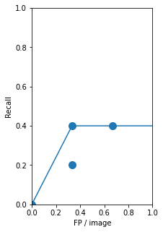
Model Evaluation -
Recall vs False Positive per Image
Suppose we have: 5 ground truth bbox for 3 images
Prediction Probability | True Positive (IoP > 0.5?) | GT BBox | Counted towards
A 0.99 | Yes | 1 (IoP = 0.9), 5 (IoP = 0.7) | 1
B 0.97 | No | - | -
C 0.81 | Yes | 2 | 2
D 0.72 | Yes | 1 | 1
E 0.58 | No | - | -
... | ... | ... | ...
After
Linear Interpolation
Threshold Probabilities from top and find recall
and FP/image
Notes:
Recall that each bounding box have probabilities which is sort of like a confidence to the prediction.
After classifying each bounding box to the prediction we can form a graph, like a

Slide 11
Model Evaluation -
Recall vs False Positive per Image
Suppose we have: 5 ground truth bbox for 3 images
FROC = average values of recall when FP/image is
¼, ½, 1, 2, 4, 8
The Final Score is the average of FROC of 4 classes
Prediction Probability | True Positive (IoP > 0.5?) | GT BBox | Counted towards
A 0.99 | Yes | 1 (IoP = 0.9), 5 (IoP = 0.7) | 1
B 0.97 | No | - | -
C 0.81 | Yes | 2 | 2
D 0.72 | Yes | 1 | 1
E 0.58 | No | - | -
... | ... | ... | ...
After
Linear Interpolation
Threshold Probabilities from top and find recall
and FP/image
Notes:
Recall that each bounding box have probabilities which is sort of like a confidence to the prediction.
After classifying each bounding box to the prediction we can form a graph, like a

Slide 12
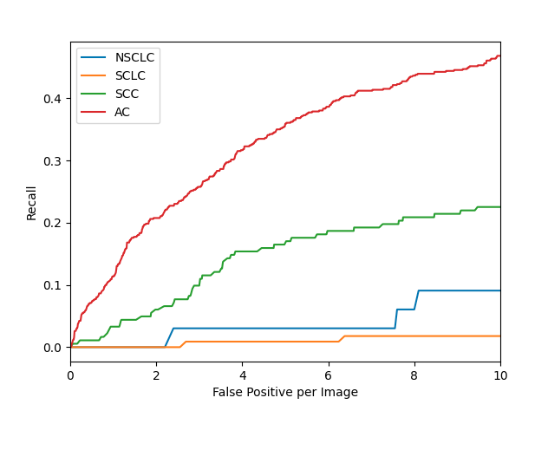
Model Evaluation - FROC
Does a model with lots of prediction bounding boxes with low confidence implies a lower expected FROC Score?
Notes:
Recall that each bounding box have probabilities which is sort of like a confidence to the prediction.
After classifying each bounding box to the prediction we can form a graph, like a

Slide 13
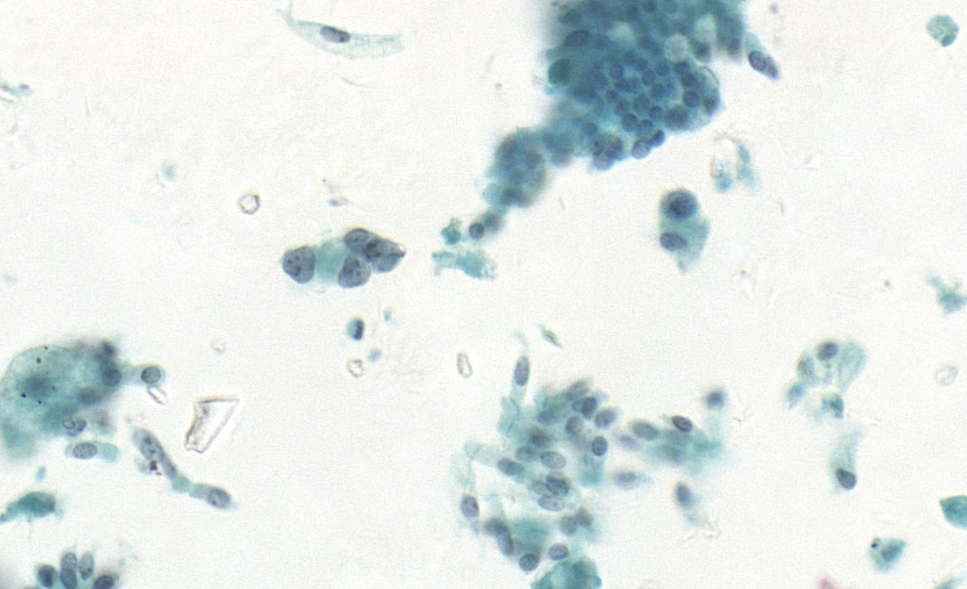
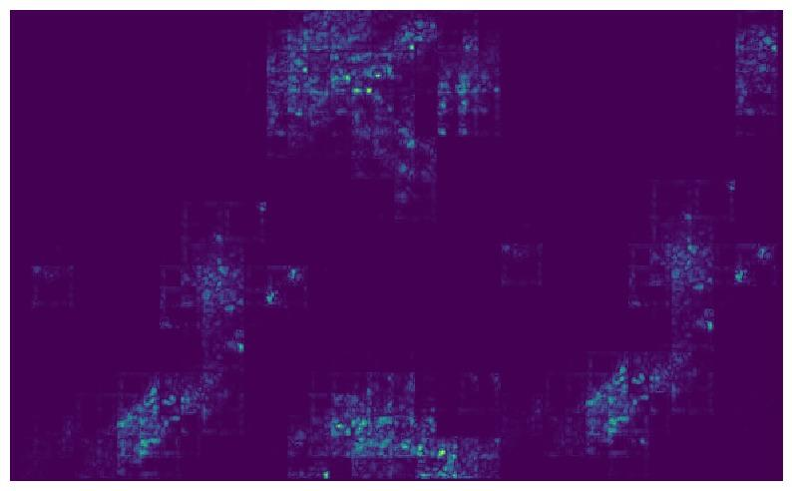
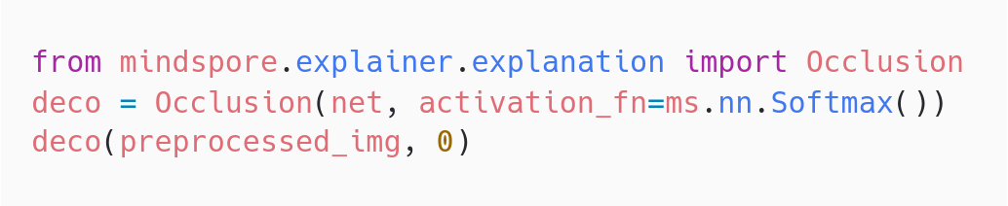
Model Evaluation - XAI
With the mindspore.explainer Occlusion explainer.
mindspore.explainer
Notes:
Recall that each bounding box have probabilities which is sort of like a confidence to the prediction.
After classifying each bounding box to the prediction we can form a graph, like a

Slide 14
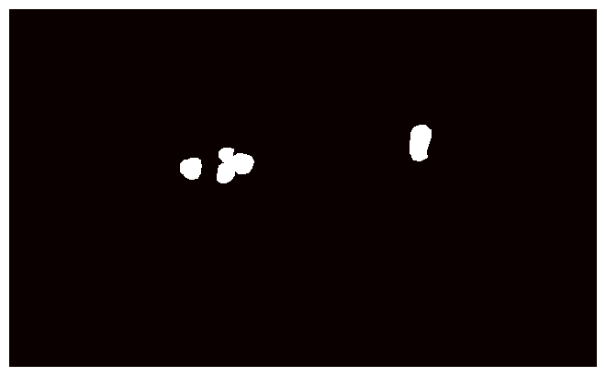
Model Evaluation - XAI
Ground Truth Image
Saliency Map
Scikit learn
Sklearn
.metrics
.roc_auc_score( , )
Some modules in mindspore.explainer could be too large for image to handle, we suggest simplifying the model design.
Notes:
Recall that each bounding box have probabilities which is sort of like a confidence to the prediction.
After classifying each bounding box to the prediction we can form a graph, like a

Slide 15
Final Pitching - Evaluation Criteria
The top 6 highest model score teams are invited to enter the FINAL PITCHING
20 mins = 15 min (Presentation) + 5 min (Q&A)
Judging Criteria | Weighting
Model Design | 20%
Explainable AI Design | 20%
Innovation and Commercialization Idea | 40%
Presentation | 20%

Slide 16
Details | Description
Topic/Solution Title | An appropriate title for the solution. Highlights the novelty of your model.
Solution Overview | Give a high-level picture to judges. Attach with a figure of the designed neural network or algorithm.
Solution Description | A detail description of each section of the overview, with details.
Result | Show and explain the result after tuning hyperparameter, or performing structural changes.
Business Context Uses | Describe how businesses can operate or use these models for profit or impact in the health industry.
The top 6 highest model score teams are invited to enter the FINAL PITCHING

Slide 17
Details | Description
Possible Improvements | Describe improvements that can be made to the solution but not achieved.
Additional Discovery from Data | Display the ability to fully understand the dataset, and the methodology used for knowledge discovery on the dataset.
Progress Report | Describe the timeline for working the competition.
Team Members | Describe each member’s details.
Acknowledgment | Acknowledge any 3rd parties, regulatory requirements that are related to the competition. Eg. Instructors, Professors, Business Partners
Appendices | Appendices & references for any additional information.

Slide 18
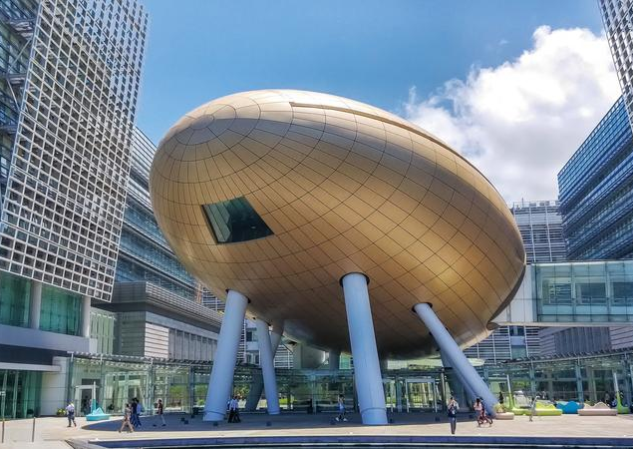
Final Pitching & Award Ceremony
Final Pitching
Date 22 October 2021 (Friday)
Venue Inno2, 17W, Hong Kong Science Park
Time 2:30pm
Agenda
Welcoming Speech
Solution Pitching
On-site Evaluation
Award Ceremony
Event Huawei Cloud Summit 2021
Date 26 October 2021 (Tuesday)
Venue Grand Hyatt Hong Kong
Time Afternoon

